Slide 1
E-cigarette Vapor Decreases Bone Marrow Hematopoietic Stem and Progenitor Cells

Slide 2
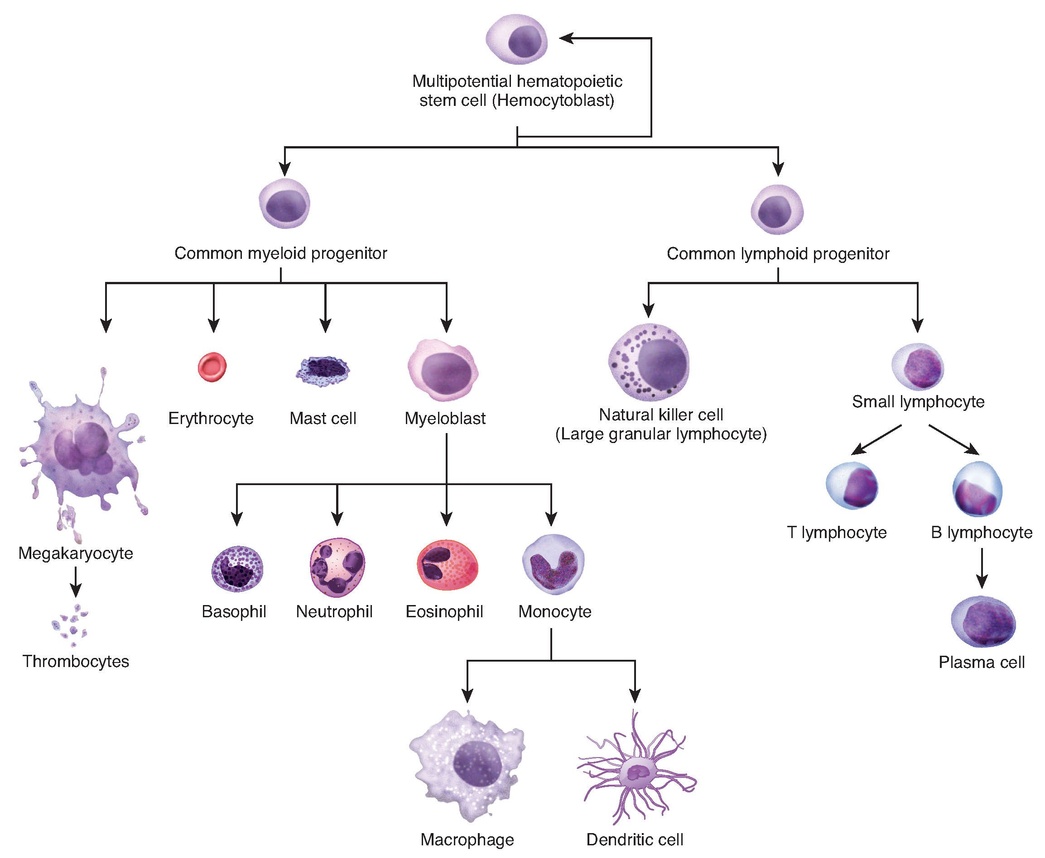
Hematopoiesis – multiple lineages from hematopoietic stem cells (HSCs)

Slide 3
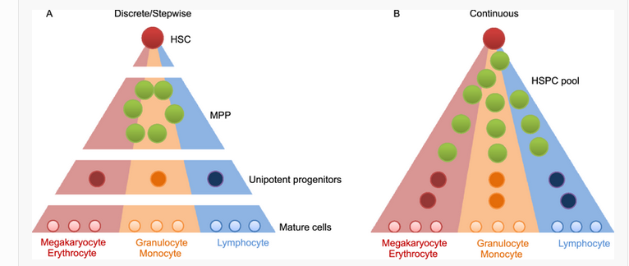
Stepwise versus continuous model of hematopoiesis

Slide 4

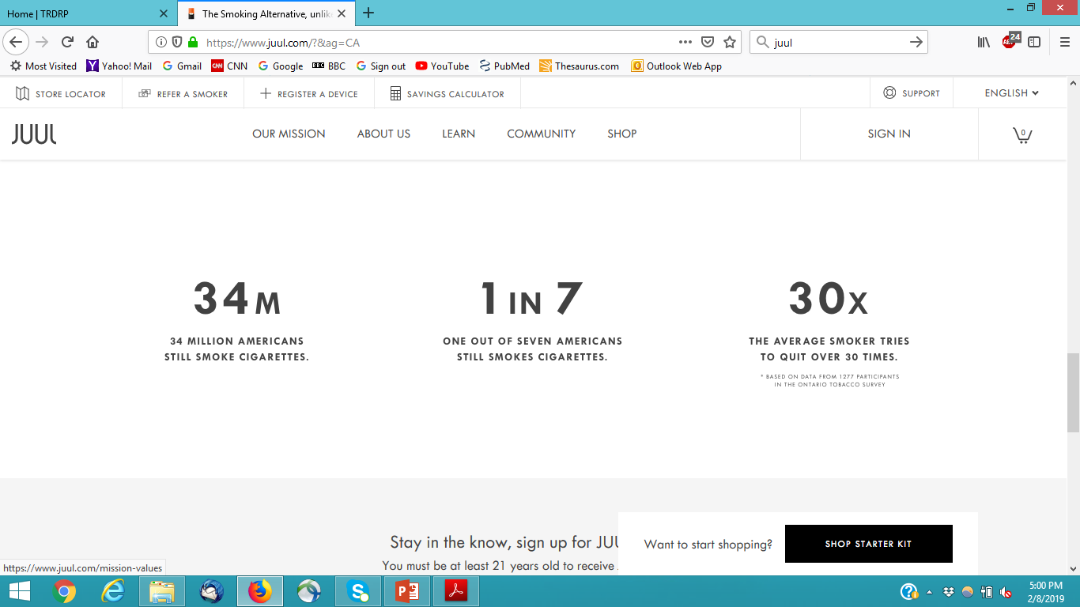
Smoking is associated with increased risk for Clonal Hematopoiesis of Indeterminate Potential (CHIP)
Gillis and Padron, 2017
Smokers have an increased inflammatory burden and smoking maybe a stimulus that triggers and drives a mutant clone.
Smoking behavior is strongly associated with the presence of clonal hematopoiesis of indeterminate potential (CHIP).

Slide 5
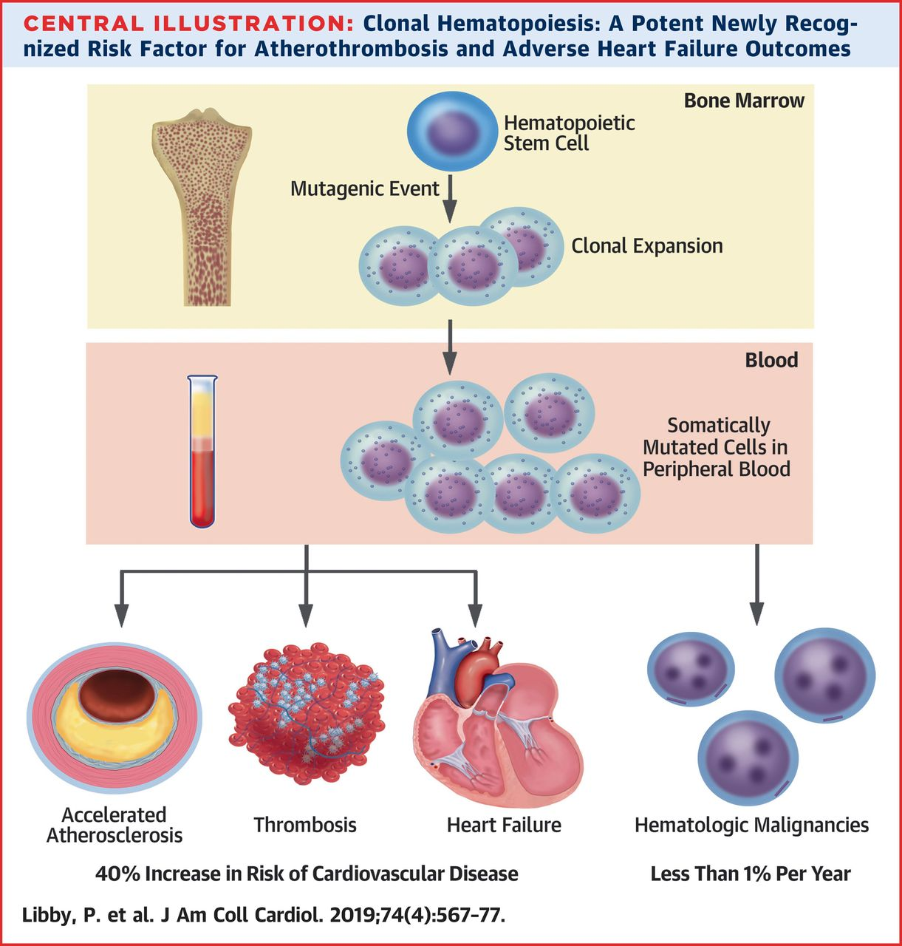
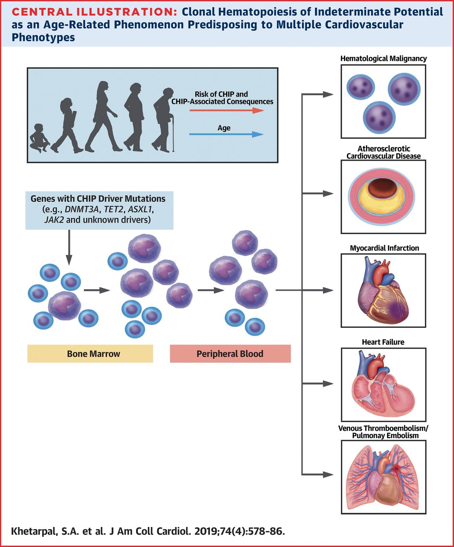
Clonal Hematopoiesis of Indeterminate Potential (CHIP)

Slide 6
Could the effects of vaping on the bone marrow lead to CHIP?
Does E-cigarette use lead to changes in bone marrow stem and progenitor populations ?
Relevance – changes in number and function of bone marrow stem cell population can increase risk for myeloid leukemia and selective advantage for mutant cells by vaping)
Hypothesis:
Vaping induces chronic oxidative stress and inflammation that can affect hematopoietic stem cell number and function leading to CHIP.
Objectives:
To determine the effects of E-cigarette vapor on the number and function of hematopoietic stem cells.

Slide 7
Experimental Design
Bone marrow HSC analysis, n=7
n=15
Air
Systemic LPS (16 hrs), HSC analysis, n=8
2 months
C57Bl6/J
n=30
8wks old, ♀
Bone marrow HSC analysis, n=7
n=15
Vape
Systemic LPS (16 hrs), HSC analysis, n=6

Slide 8
Characterization of hematopoietic stem and progenitor cells (HSPCs) by flow cytometry
Bri Craver
Notes:
A very rare population of cells. Hematopoietic tree.

Slide 9
E-cigarette vapor decreases the frequency and absolute numbers of bone marrow HSPCs
Notes:
Animation: each subset.

Slide 10
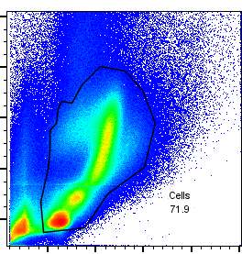
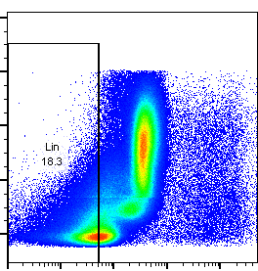
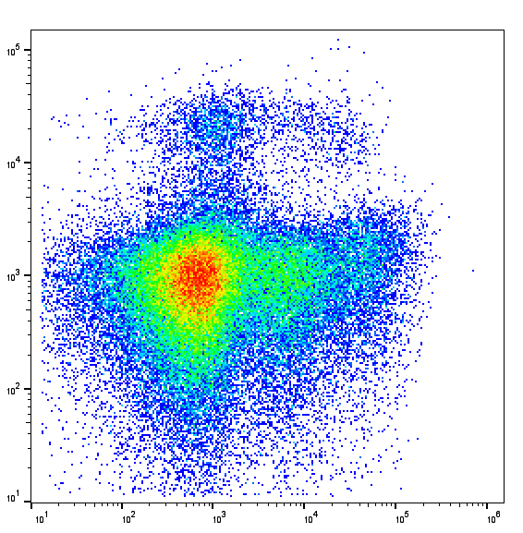
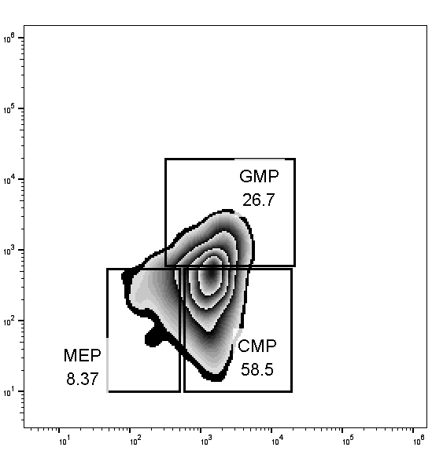
Frequency of myeloid progenitors is decreased after E-cigarette vapor exposure
LK
CD16/32
C-Kit
Lineage
Sca-1
CD34

Slide 11
HSC function appears unperturbed in primary transplants
Notes:
BrdU data before transplant, cycling and function

